Slide 1
PureEdge VOIP
Join the conversation at:
(570) 664-0855
PIN: 1133
User Training for Polycom VVX desksets

Slide 2
What is PureEdge VOIP?
Cloud-based voice platform
  Uses your Internet service
Enterprise-wide
  One System/Multiple Sites
Easy to use

Slide 3
Key Features
Caller ID – even to your cell phone!
User-controllable Call Routing
Voicemail-to-Email
Office-to-Office Extension Dialing

Slide 4
Two types of extensions
Standard Extension
  Assigned to a physical telephone
Cloud Extension
  Assigned to an agent that does not have a dedicated telephone

Slide 5
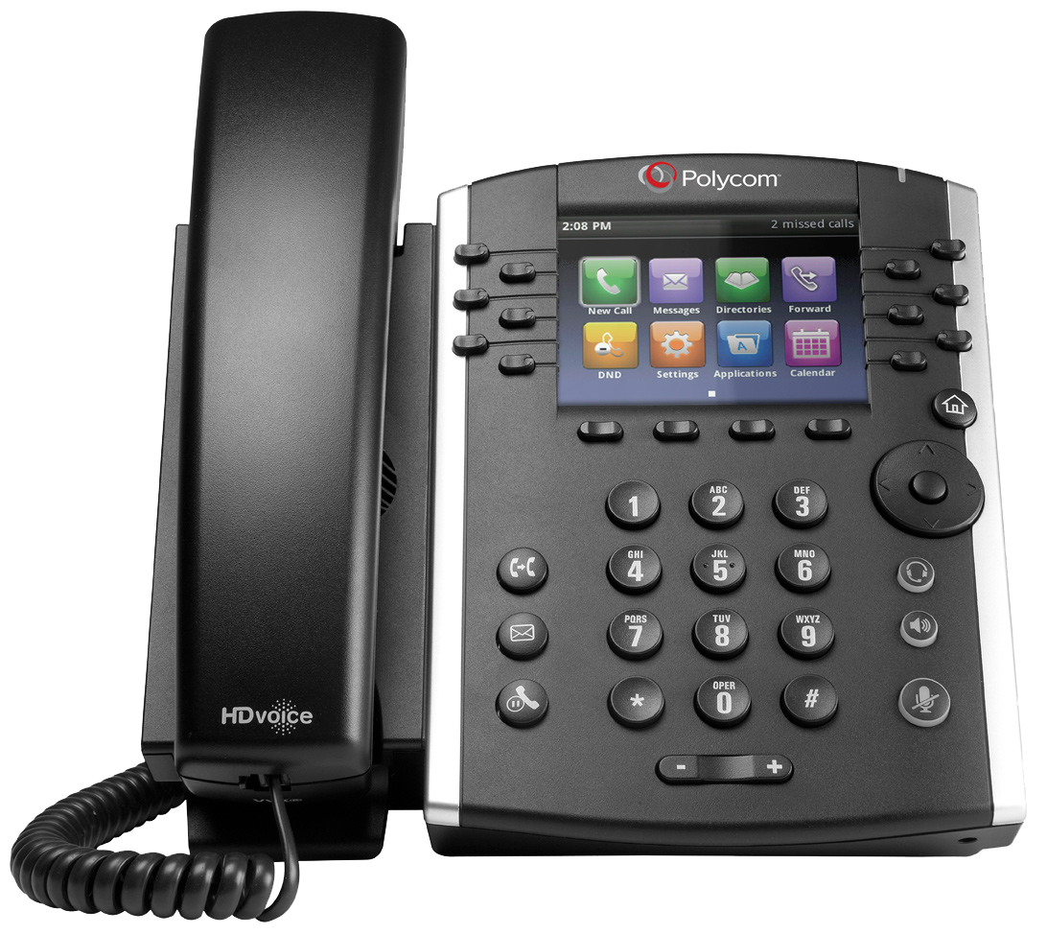
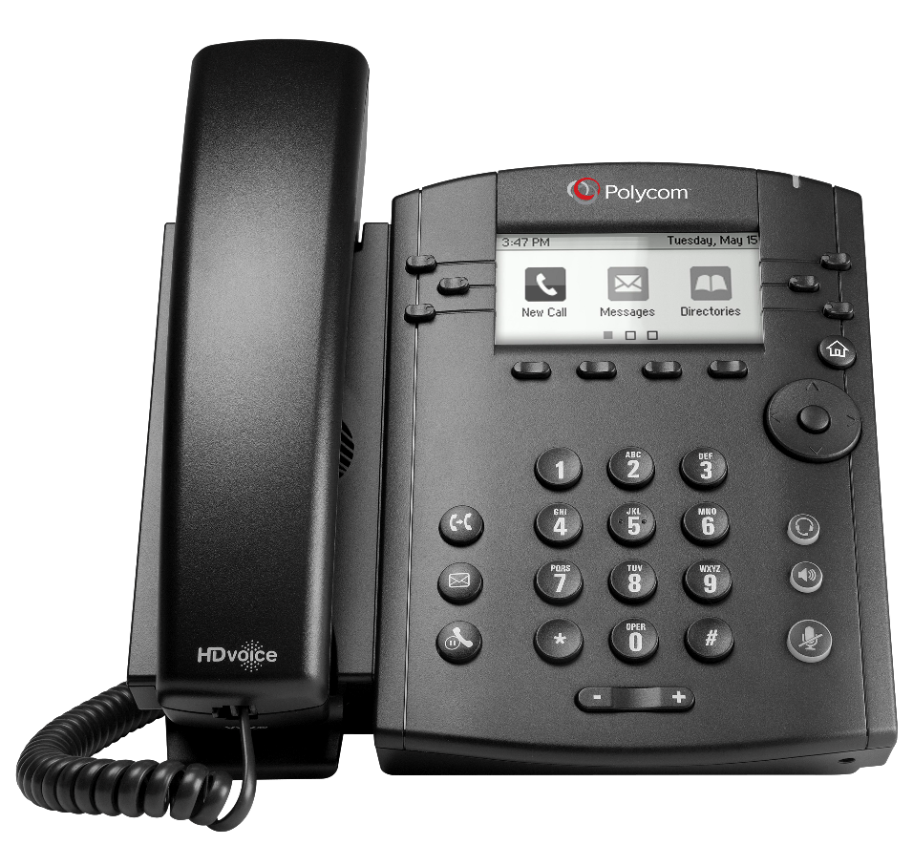
Polycom phones
VVX 400
VVX 300

Slide 6

Line Keys, Park, BLF’s
Message Waiting
Home
Soft Keys
Directional Pad
Transfer
Messages
Headset
Hold
Speakerphone
Volume Control
Mute

Slide 7
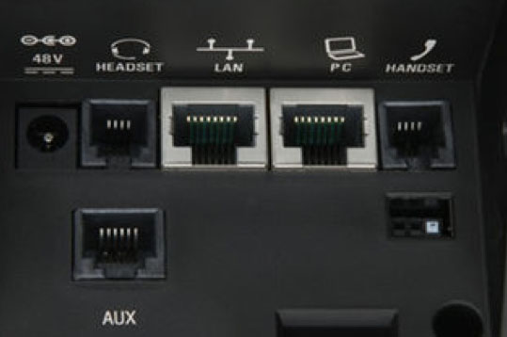
Connecting the phone
LAN Port
Active Data Jack
Power-Over-Ethernet
Connect this port to your
network jack
PC Port (optional use)
Computer
Printer
The phone knows who it is. If a phone is moved, it will keep its extension number.
So, take your phone with you!

Slide 8
Using the Polycom phones

Slide 9

Hey! The phone is ringing!
Pick up the handset
Press the Speaker button
Press the Headset button
To pick up a different extension:
Dial *8 + the extension of the ringing phone
Press SEND soft key

Slide 10
Reach out and touch someone
Pick up handset (or press Speaker or Headset)
Dial Extension Number or Telephone Number
  no need for “9”, however you MUST dial the Area Code
Press SEND softkey

Slide 11
Call Center
Log In: *01 + Agent Code + SEND
Log Out: *00 + Agent Code + SEND
Make “Busy”: *02 + Agent Code + Reason Code + SEND
  1 = Wrap-Up Time
  2 = Restroom
  3 = Break
  4 = Lunch
Remove “Busy”: *03 + Agent Code + SEND
Agent Code = YOUR EXTENSION NUMBER

Slide 12
Call Handling
Transfer
  Blind/Unattended
  Supervised/Attended
Hold (Personal)
Park (System)

Slide 13

Call Handling
BLIND TRANSFER
Press TRANSFER button or soft key
Call the other party
Press SEND
Hang up
SUPERVISED TRANSFER
Press TRANSFER button or soft key
Press the CONSULTATIVE soft key
Call the other party
Press SEND
After hearing ringback or speaking to other party, press TRANSFER again

Slide 14
Call Handling
TRANSFER TO VOICEMAIL
Press TRANSFER button or soft key
Dial extension number followed by *
Press SEND
Hang up

Slide 15

Call Handling
HOLD
Press HOLD button
Press blinking line key to retrieve
The Hold feature is useful when you will retrieving the call from the same phone

Slide 16

Call Handling
PARK
Press available Park button
Call will be released from phone and will light red on all phones
RETRIEVE
Press the lit Park button
  If no Park key, dial *71 + the parking location (i.e. *711, *712, etc)

Slide 17

Paging
The Polycom phones support Group Paging, which will allow one-way announcements through all phones in the office.
Press the PAGING softkey
Press PAGE softkey
Begin speaking
Press END PAGE softkey or hang up

Slide 18

Let’s make this a party!
The PureEdge VOIP system supports 3-way calling
Call the first party
Press MORE soft key
Press CONFRNC soft key
Dial and connect with second party
Press CONFRNC again
Tips for managing 3-way calls are in the PureEdge User Guide

Slide 19


Do Not Disturb
For Standard Extensions, if the phone is placed in Do Not Disturb mode, the system will treat the phone as “Busy”
To toggle Do Not Disturb:
Press DND softkey
or
Press DND on Home Screen
The DND icon will appear next to your extension number

Slide 20
Voicemail

Slide 21
Checking voicemail
From a Standard Extension:
Press the MESSAGE button
Enter password followed by #
From any extension:
Dial * plus your extension number
Enter password followed by #
From any outside phone:
Call any office number that goes to an auto attendant
Press #
Enter your extension number
Enter password followed by #
Voicemail-to-Email:
Caller ID information
Time Stamp
Voicemail as an attachment

Slide 22
First Time Enrollment
When you log into voicemail for the first time, you will be asked to
Record your Name
Record your Unavailable Greeting
Record your Busy Greeting
Set a new Security Code
If you do not accomplish these tasks, you will be asked to do so every time you log in
Default Security Code =
YOUR EXTENSION NUMBER

Slide 23
PureEdge Portal

Slide 24
PureEdge Portal
http://pureedgevoip.com
Username: your business e-mail address
Password: PureEdge101
Case Sensitive

Slide 25

But why would I want to?
Retrieve voicemail messages
Modify extension routing
Change mailbox settings

Slide 26
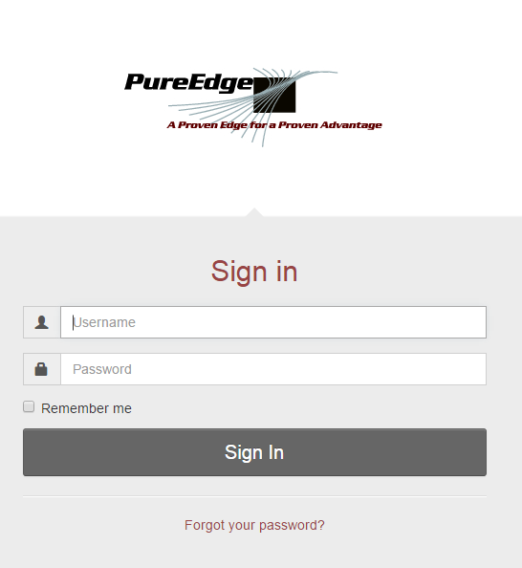
Login Screen

Slide 27
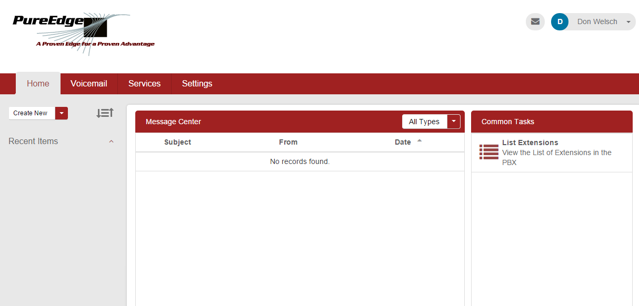
Home Screen

Slide 28
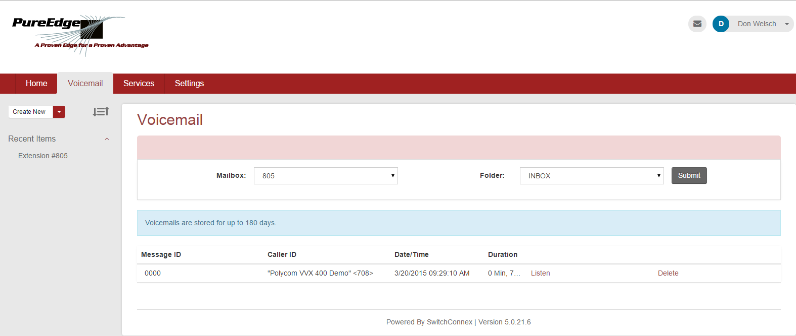
Voicemail Tab

Slide 29
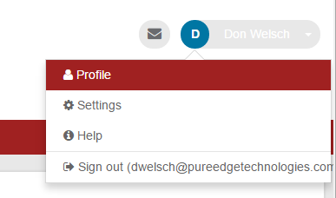
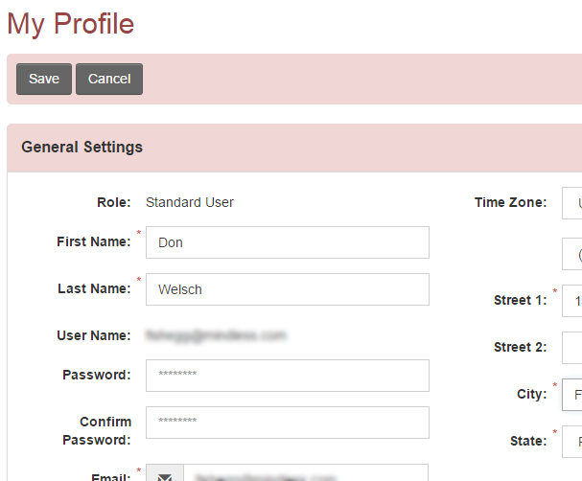
Profile Settings
Change your Password!!

Slide 30
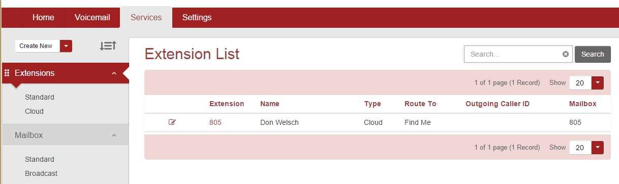
Extension Settings
Click on the Services tab
Click on your extension number

Slide 31
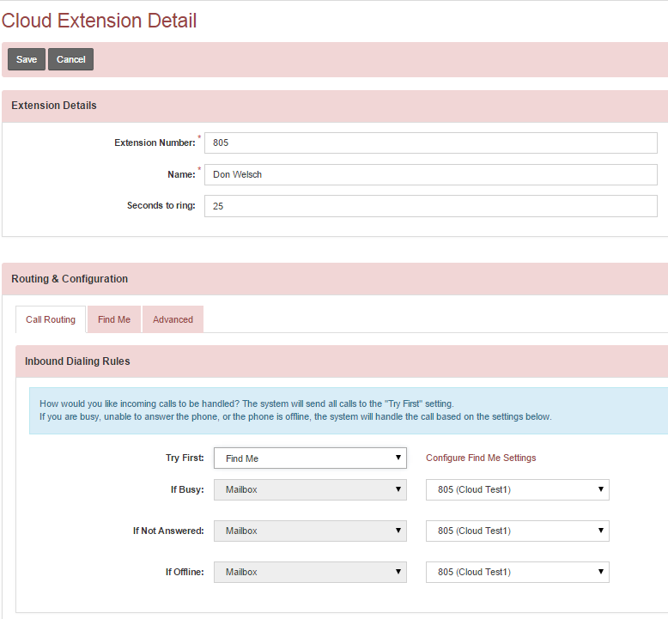
Call Routing
Valid Destinations
Extension
Phone
Mailbox
Outside Number
Find Me

Slide 32
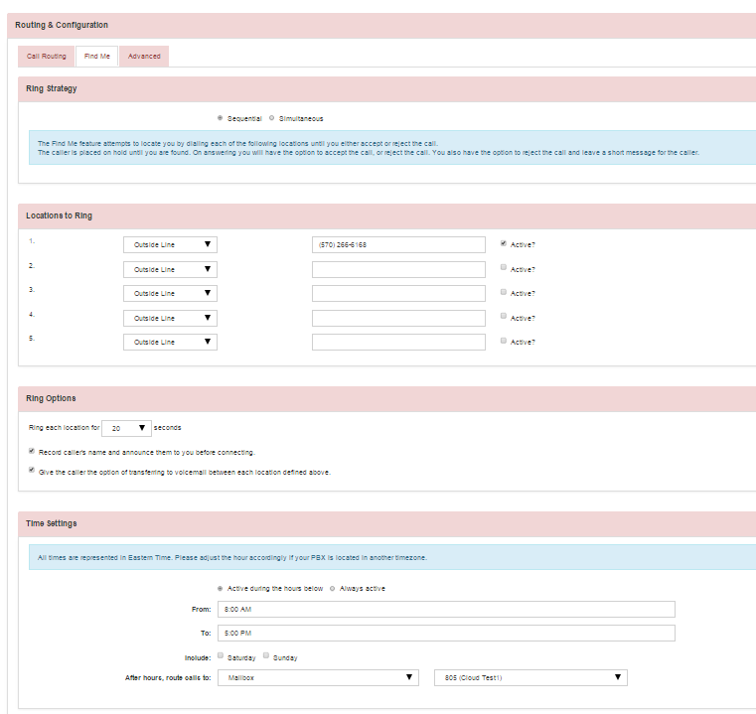
Find Me
  Sequential or Simultaneous
Up to five locations
  Internal or External
  Ring Timer
  Call Screening
Time Settings
  Note: Currently, must be set on Eastern Standard Time

Slide 33
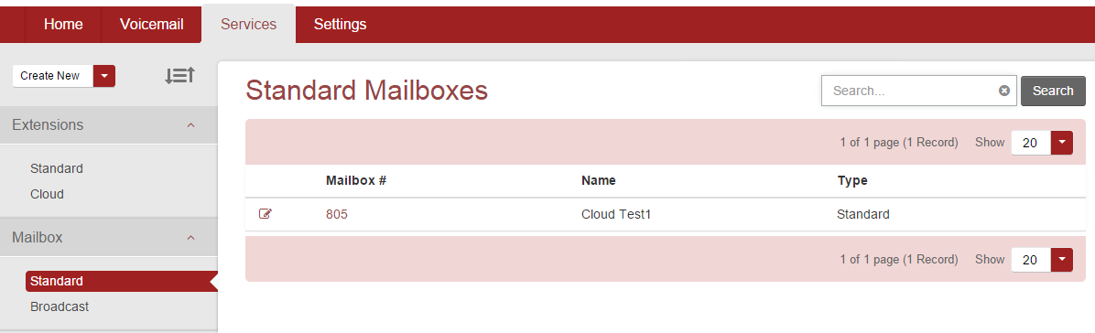
Mailbox Settings
In the left-hand menu under Mailbox, click on Standard
Click on your Extension number

Slide 34
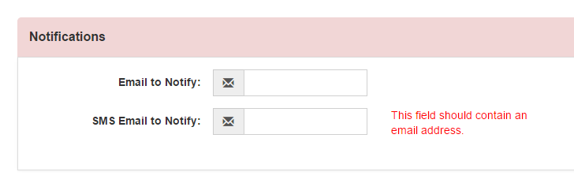
Mailbox Settings
Change your Mailbox password
Change mailbox options
Change email/text notification
Two e-mail addresses
  E-mail – contains message as an attachment
  SMS E-mail – Envelope information only
    Verizon: ##########@vtext.com
    Sprint: ##########@messaging.sprintpcs.com
    AT&T: ##########@text.att.net

Slide 35

Questions?

