Slide 1

For Audio:
Phone: (646) 439-2146
Room: 108#
Password: 2468
User Training for Yealink T Series Desk Phones
support.mynexline.com

Slide 2
What is TelNexa?
Cloud-based voice platform
  Uses your Internet service
Enterprise-wide
  One System/Multiple Sites
Easy to use

Slide 3
Key Features
Caller ID – even to your cell phone!
User-controllable Call Routing
Voicemail-to-Email
Multiple Phone Options
  Deskphone
  Browser-based
  Smartphone

Slide 4
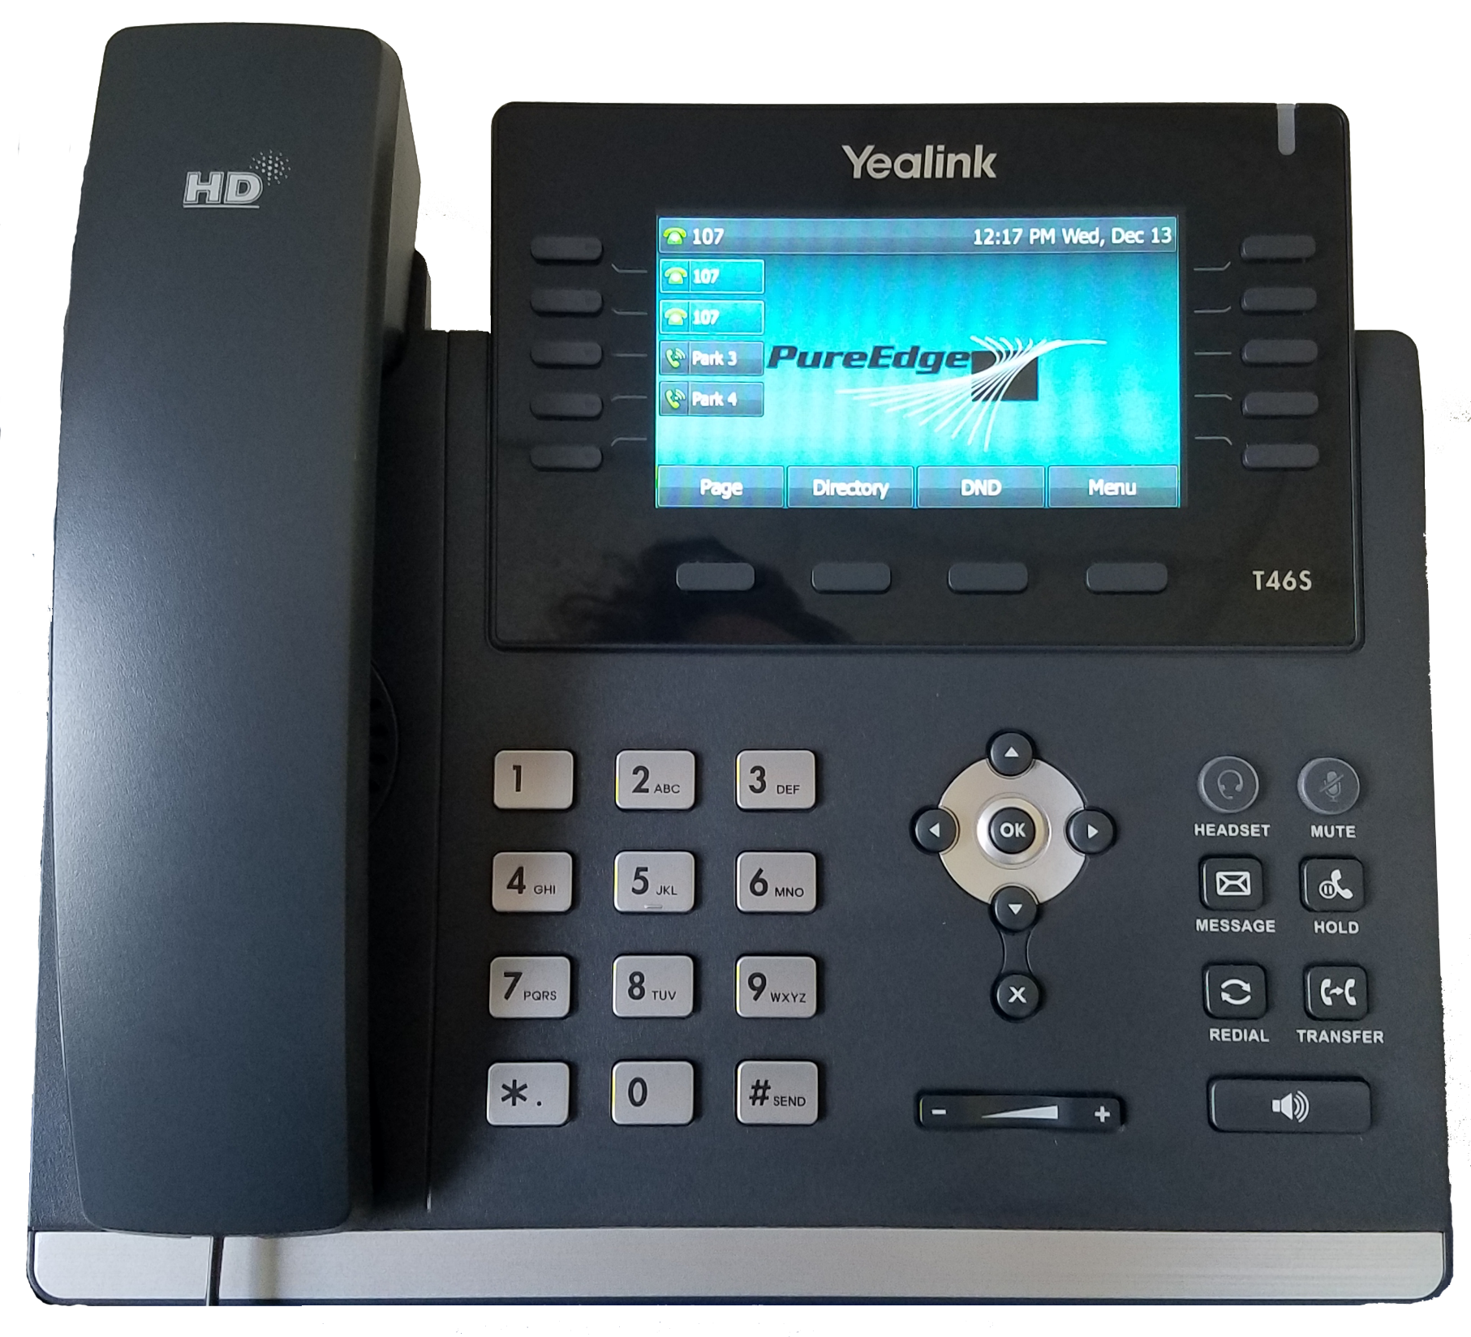
Line Keys, Park, BLF’s
(3 Pages)
Message Waiting
Soft Keys
Headset
Mute
Messages
Hold
Directional Pad
Redial
Transfer
Volume Control
Speakerphone

Slide 5
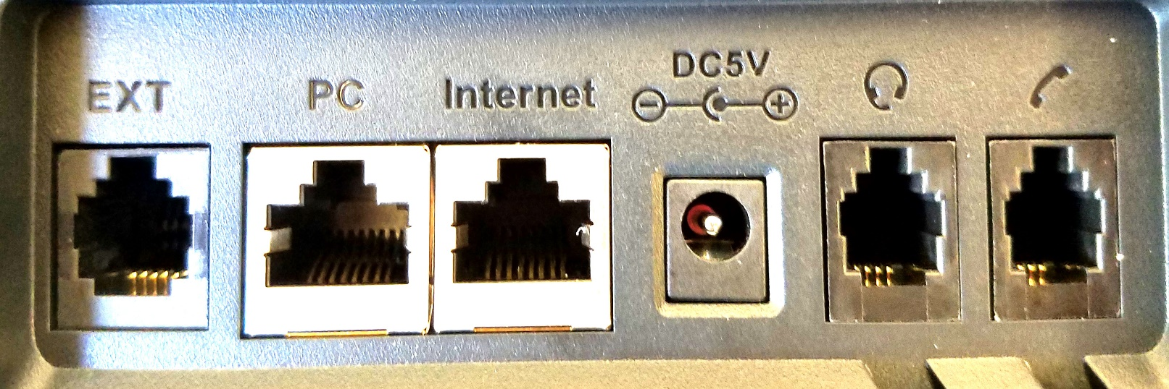
Connecting the phone
LAN Port
Active Data Jack
Power-Over-Ethernet
Connect this port to your
network jack
PC Port (optional use)
Computer
Printer
The phone knows who it is. If a phone is moved, it will keep its extension number.
So, take your phone with you!

Slide 6
Using the Yealink phones

Slide 7

Hey! The phone is ringing!
Pick up the handset
Press the Speaker button
Press the Headset button
To pick up a different extension:
Dial *8 + the extension of the ringing phone
Press CALL soft key

Slide 8
Reach out and touch someone
Pick up handset (or press Speaker or Headset)
Dial Extension Number or Telephone Number
  no need for “9”, however you MUST dial the Area Code
Press CALL softkey
Intercom Call
Press “X” + Extension Number
  or Dial *1 + Extension Number
Press CALL softkey

Slide 9
Call Center
Log In: *01 + Agent Code + CALL
Log Out: *00 + Agent Code + CALL
Make “Busy”: *02 + Agent Code + Reason Code + CALL
  1 = Wrap-Up Time
  2 = Restroom
  3 = Break
  4 = Lunch
Remove “Busy”: *03 + Agent Code + CALL
Agent Code = YOUR EXTENSION NUMBER

Slide 10
Call Handling
Transfer
  Blind/Unattended
  Supervised/Attended
Hold (Personal)
Park (System)

Slide 11

Call Handling
BLIND TRANSFER
Press TRANSFER button or soft key
Call the other party
Press TRANSFER again
SUPERVISED TRANSFER
Press TRANSFER button or soft key
Dial the other party and press #
After hearing ringback or speaking to other party, press TRANSFER again

Slide 12
Call Handling
TRANSFER TO VOICEMAIL
Press TRANSFER button or soft key
Dial extension number followed by *
Press TRANSFER
Hang up
Pro Tip:
Dial Extension + * to quickly leave someone a voicemail

Slide 13

Call Handling
HOLD
Press HOLD button or softkey
Press blinking line key to retrieve
The Hold feature is useful when you will be retrieving the call from the same phone

Slide 14

Call Handling
PARK
Press available Park button
Call will be released from phone and will light red on all phones
RETRIEVE
Press the lit Park button
  If no Park key, dial *71 + the parking location (i.e. *711, *712, etc)

Slide 15

Paging
The Yealink phones support Group Paging, which will allow one-way announcements through phones in the office.
Press the PAGE softkey
Select Page Zone
  1 = Default
  24 = Priority (Active calls placed on Hold)
  25 = Emergency (DND Override, Active calls placed on Hold)
Pickup handset and begin speaking
Press END CALL softkey or hang up

Slide 16
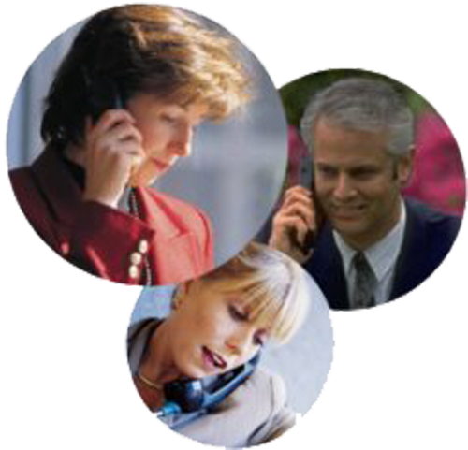
Let’s make this a party!
The Yealink phones supports 3-way calling
Call the first party
Press CONF soft key
Dial and connect with second party
Press CONF again
Tips for managing 3-way calls are in the TelNexa User Guide

Slide 17


Do Not Disturb
For Standard Extensions, if the phone is placed in Do Not Disturb mode, the system will treat the phone as “Busy”
To toggle Do Not Disturb:
Press DND softkey
or
Press DND on Home Screen
The DND icon will appear at the top of the display

Slide 18
Voicemail

Slide 19
Checking voicemail
From a Standard Extension:
Press the MESSAGE button
Enter password followed by #
From any extension:
Dial * plus your extension number
Enter password followed by #
From any outside phone:
Call any office number that goes to an auto attendant
Press #
Enter your extension number
Enter password followed by #
Voicemail-to-Email:
Caller ID information
Time Stamp
Voicemail as an attachment

Slide 20
First Time Enrollment
When you log into voicemail for the first time, you will be asked to
Record your Name
Record your Unavailable Greeting
Record your Busy Greeting
Change your Security Code
If you do not accomplish these tasks, you will be asked to do so every time you log in
Default Security Code =
YOUR EXTENSION NUMBER

Slide 21
Teams (UC) & Corenexa Mobile App

Slide 22
Three Solutions for Mobile Users
CoreNexa Web UC
Runs in most modern web browsers
Make and Receive Phone Calls
User Presence
Video Conferencing
Chat/SMS
Voicemail Management
Call History
CoreNexa Mobile App
Android or IOS (search for “Corenexa” in your App Store)
Make and Receive Phone Calls
  WiFi/Cellular or WiFi Only
Set Call Forwarding and DND
Chat/SMS
Voicemail Management
Virtual Attendant Switching
CoreNexa Desktop
Windows/Mac/Linux
Make and Receive Phone Calls
User Presence
Video Conferencing
Chat
Voicemail Management
Call History

Slide 23
TelNexa Portal
http://login.mynexline.com
Username: your business e-mail address
Password: NexLine101
Case Sensitive

Slide 24

Questions?
http://support.pureedgevoip.com
support@mynexline.com

